Slide 1




Bidirectional English-Hindi Translation and Speech-to-Speech Translation
A Unified Framework for Regional LLM Adaptation
Prof. Rajiv Misra
Indian Institute of Technology Patna

Slide 2

THE NEED FOR SOVEREIGN AI
Regional Localization
Architectural Shift
As LLMs serve diverse populations, developing sovereign foundation models for morphologically rich languages like Hindi is a critical shift in the industry.
Moving from dedicated Encoder-Decoder pairs to unified Causal LLMs requires exploring stability during Parameter-Efficient Fine-Tuning (PEFT).

Slide 3
Preliminary Baseline Paradigms
Causal LMs (GPT-2)
Suffer from severe “Embedding Tax.” Standard BPE extensively fragments Devanagari.
Seq2Seq (mT5-small)
Parameter inefficient for targeted tasks; architectural capacity consumed by massive 250k vocabulary.
Helsinki - NLP
Strong grammatical foundations but suffers severe domain mismatch on indic origin datasets like IIT-B.

Slide 4
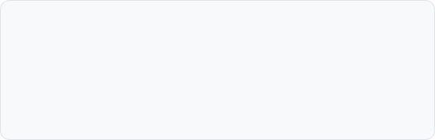
INDIC FOUNDATION MODELS & Dataset
Dataset Used
Training: AI4Bharat Samanantar corpus with 100k English–Hindi parallel pairs.
Evaluation: IN22-Gen benchmark, used as an uncontaminated test set for fair comparison.
Sarvam-1 (2.0B)
Regional causal Indic model with efficient native tokenization.
Pragna-1B (1.25B)
Decoder-only efficiency benchmark featuring RSNorm.
Param-1 (2.9B)
Largest model tested, featuring Grouped-Query Attention (GQA).

Slide 5
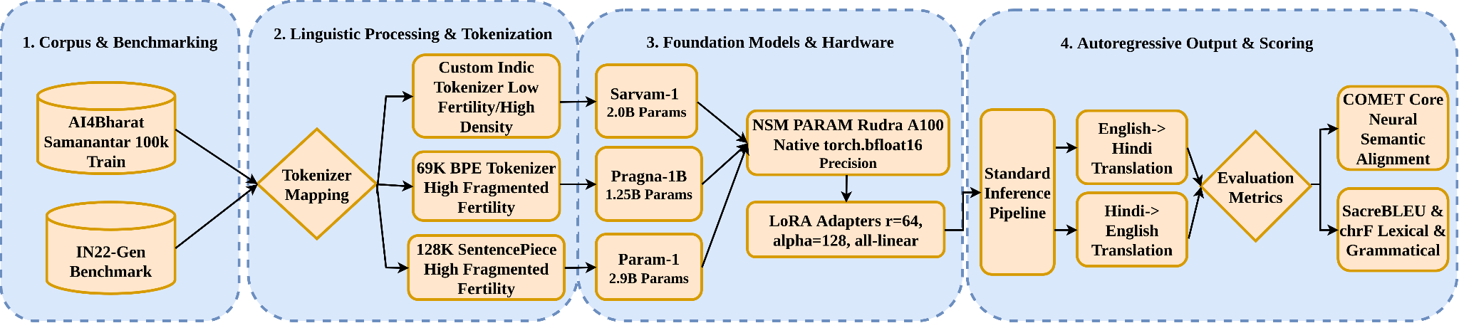
Experimental Pipeline
PEFT Configuration
LoRA Rank r = 64, Alpha = 128
Target: All-linear layers
Dropout: 0.05
Precision: Native BFloat16 (no quantization noise)

Slide 6
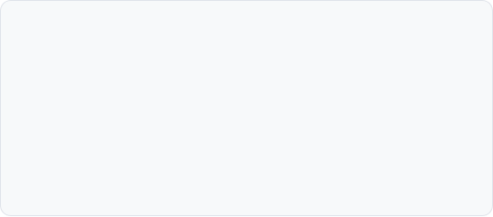
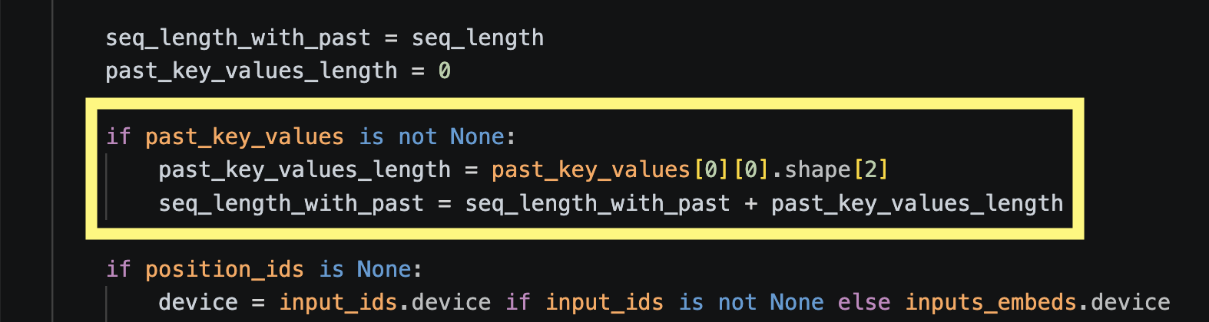
ARCHITECTURAL VULNERABILITIES
KV Cache Collapse
Param-1's GQA implementation contains a critical initialization flaw that triggers a NoneType Error during early-stage inference.
Crash Trigger: past_key_values[0][0].shape[2] -> None
The forward pass assumes the cache is pre-populated at t=0, making standard PEFT pipelines mathematically impossible without surgical architectural patches.

Slide 7
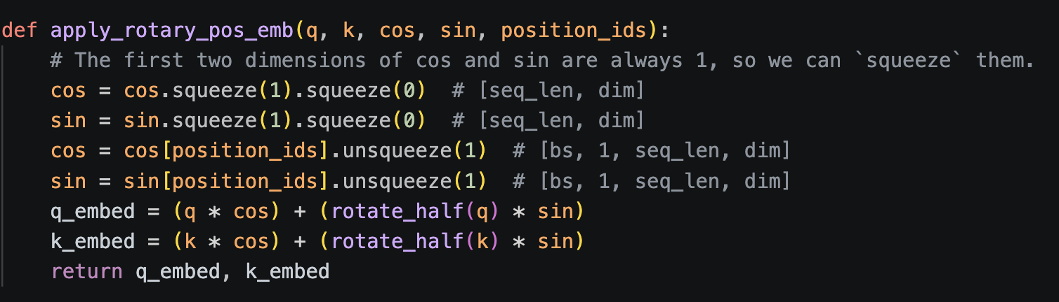
ARCHITECTURAL VULNERABILITIES
RoPE Geometry Violation
After patching KV cache bug, corrupted sequence lengths cause position IDs to exceed allocated cosine/sine cache boundaries, triggering CUDA device assertion errors.

Slide 8
THE TOKEN FERTILITY ADVANTAGE (Sarvam-1)
Native Indic tokenization reduces the "Embedding Tax" significantly compared to multilingual models.
2.1x
4x
8k
Sarvam-1 Token Fertility
Efficiency Gain vs. BPE
Token Context Window

Slide 9
IN22-GEN: ENGLISH TO HINDI
Model Architecture | Params | BLEU | chrF | COMET
IndicTrans2 (Oracle) | ~1.0B | 23.40 | 53.80 | 82.10
Sarvam-1 | 2.0B | 19.92 | 47.67 | 77.02
Param-1 (Control) | 2.9B | 12.19 | 42.94 | 59.79
Pragna-1B | 1.25B | 8.64 | 32.39 | 63.62

Slide 10
IN22-GEN: HINDI TO ENGLISH
Model Architecture | Params | BLEU | chrF | COMET
IndicTrans2 (Oracle) | ~1.0B | 29.10 | 57.50 | 85.40
Sarvam-1 | 2.0B | 24.37 | 54.51 | 86.02
Param-1 (Control) | 2.9B | 7.32 | 19.12 | 38.19
Pragna-1B | 1.25B | 18.86 | 46.10 | 81.09
Sarvam-1 surpasses to oracle IndicTrans 2 on Hindi-to-English semantic alignment in COMET scores.

Slide 11

Translations
Sarvam-1 Mastery
Pragna-1B Weakness
Param-1 Collapse
English → Hindi
"Patients are advised to consult their doctors before starting any new medication or dietary supplements."
Result:
मरीजों को सलाह दी जाती है कि वे किसी भी नई दवा या आहार पूरक शुरू करने से पहले अपने डॉक्टर से परामर्श करें。
Hindi → English
"मरीजों को कोई भी नई दवा या आहार पूरक शुरू करने से पहले अपने डॉक्टरों से परामर्श करने की सलाह दी जाती है।"
Result:
Patients are advised to consult their doctors before starting any new medication or dietary supplement.
English → Hindi
"Patients are advised to consult... dietary supplements."
Result:
मरीजों को नए दवाओं या आहार सब्सिडी के शुरू करने से पहले...
Hindi → English
"...हजारों भक्त एकत्र हुए।"
Result:
Despite the heavy downpour, lakhs of devotees thronged the temple...
English → Hindi
"Patients are advised to consult... dietary supplements."
Result:
इसके अलावा, इस फोन में 12 मेगापिक्सल का कैमरा दिया गया है। ...
Hindi → English
"मरीजों को कोई भी नई दवा या आहार पूरक शुरू करने से पहले..."
Result:
Police reached the spot and brought the situation under control.

Slide 12
Qualitative Analysis
Sarvam-1 Mastery
Pragna-1B Weakness
Param-1 Collapse
Medical Precision: Accurate mapping of "dietary supplements" to "आहार पूरक".
Magnitude: Preserves values like "thousands" and "promising" ("आशाजनक").
Vocabulary Miss: Maps "dietary supplements" to "आहार सब्सिडी" (subsidy).
Magnitude Errors: Scaled "thousands" ("हजारों") to "lakhs" incorrectly.
Severe Hallucinations: Injects "12MP camera" strings into medical text.
Domain Collapse: Medical advice replaced with smartphone review loops.

Slide 13
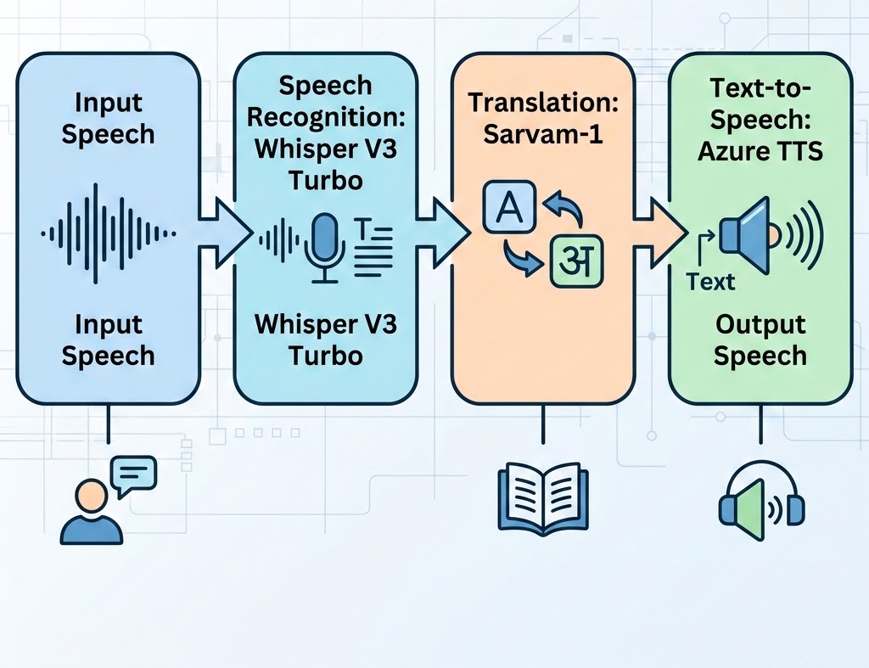
CASCADED S2ST ARCHITECTURE
A three-tier cascaded pipeline designed for modularity and high-precision translation:
ASR: Whisper V3 Turbo for accent-resistant Indian speech recognition.
MT: Fine-tuned Sarvam-1 for semantic mastery.
TTS: Azure Neural TTS (hi-IN-Madhur) for localized voice synthesis.

Slide 14

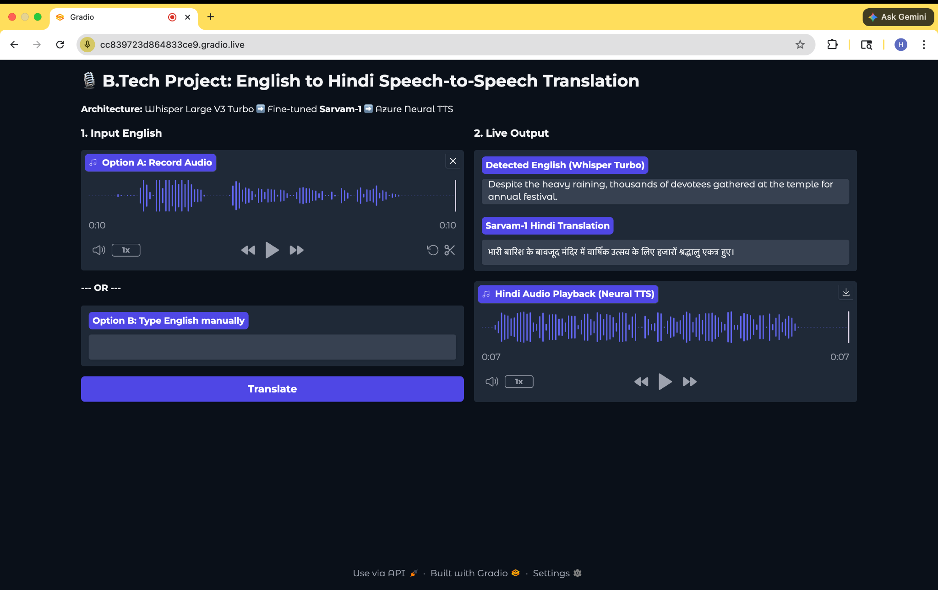

REAL-TIME DEPLOYMENT
Operationalized via a Gradio interface for seamless, high-performance interaction across languages.
Video Demonstrations
English to Hindi
Hindi to English

Slide 15
AI Applications for Hindi Population
Practical, voice-first use cases across healthcare, agriculture, and tourism
H
Healthcare
A
Agriculture
T
Tourism
Multilingual medical diagnosis via ASR-MT-TTS pipeline
Real-time accent-resistant symptom reporting for rural clinics
Localized voice synthesis for patient instructions in Hindi
Voice-enabled Mandi price discovery using fine-tuned Sarvam-1
Agricultural scheme guidance via high-precision semantic translation
Low-literacy friendly weather and pest alerts through TTS
Hindi voice concierge for heritage storytelling
Real-time cross-language navigation and booking assistance
Safety support via seamless high-performance interaction
Design principle: Hindi-first, low-literacy friendly, voice-enabled, and culturally localized.

Slide 16



CONCLUSION & KEY INSIGHTS
Stability > Scale
Tokenizer Impact
Live Applicability
Parameter count is irrelevant if foundational tensor geometry (KV Cache/RoPE) is misaligned.
Native Indic tokenizers are the primary driver of superior COMET scores and 2-4x efficiency.
Cascaded S2ST pipelines demonstrate the real-world feasibility of fine-tuned regional LLMs.

Slide 17
Questions ?

Slide 18
THANK YOU

